Slide 1
NAME-338 Ship Design Project & Presentation
Supervised by,
Dr. N. M. Golam Zakaria
Professor,
Dept. of NAME,
BUET.
Presented by,
Touseef Hasan
Student ID: 1812044,
Mehedi Hasan
Student ID: 1712046.

Slide 2
Owner’s Requirements
Vessel Type: Bulk Carrier
Capacity: 2300 tonnes
Service Speed: 10 knots
Route: Dhaka – Chittagong (Inland)
Route Distance: 315 km (171 nautical miles)

Slide 3
Principal Particulars
Length Overall
Length between Perpendiculars
Breadth Mld.
Depth Mld.
Draft
Service Speed
CB
: 76.4 m
: 74.4 m
: 13.54 m
: 5.1 m
: 3.85 m
: 10 knots
: 0.79

Slide 4
List of Contents
Scantling Calculations
Midship Section Drawing
Longitudinal Construction Drawing
Shell Expansion Drawing

Slide 5
Scantling Calculations
Reference Book: Germanischer Lloyd – Rules for Classification
and Construction (Edition 2013)

Slide 6
Scantling Calculations (contd.)
Summary: Thickness of Plates
Items | Dimension (Thickness)
Bottom Shell Plate | 11 mm
Bilge Plate | 10 mm
Side Shell Plate | 11 mm
Keel Plate | 13 mm
Deck Plate | 8 mm

Slide 7
Scantling Calculations (contd.)
Summary: Bottom Structure
Items | Dimension
Bottom Longitudinal | L-200x150x10
Bottom Center Girder | T-850x550x9
Bottom Side Girder | T-800x450x7
Inner Bottom Longitudinal | L-200x150x9
Floor | T-900x450x8

Slide 8
Scantling Calculations (contd.)
Summary: Side Structure
Items | Dimension
Main Frame | L-175x100x8
Web Frame | T-250x200x10
Side Longitudinal | L-150x75x8

Slide 9
Scantling Calculations (contd.)
Summary: Deck Structure
Items | Dimension
Deck Longitudinal | L-100x75x7
Deck Web | T-200x100x10

Slide 10
Scantling Calculations (contd.)
Summary: Watertight Bulkheads
Items | Dimension
Plate | t = 9 mm
Web | T-200x100x9
Vertical Stiffeners | L-75x50x9
Transverse Stiffeners | L-90x65x7

Slide 11
Scantling Calculations (contd.)
Summary: Superstructure
Items | Dimension
Top Plate | t = 7 mm
Side Plate | t = 9 mm
Side Frame | L-125x75x7
Web Frame | T-250x175x9
Deck Longitudinal | L-100x75x7

Slide 12
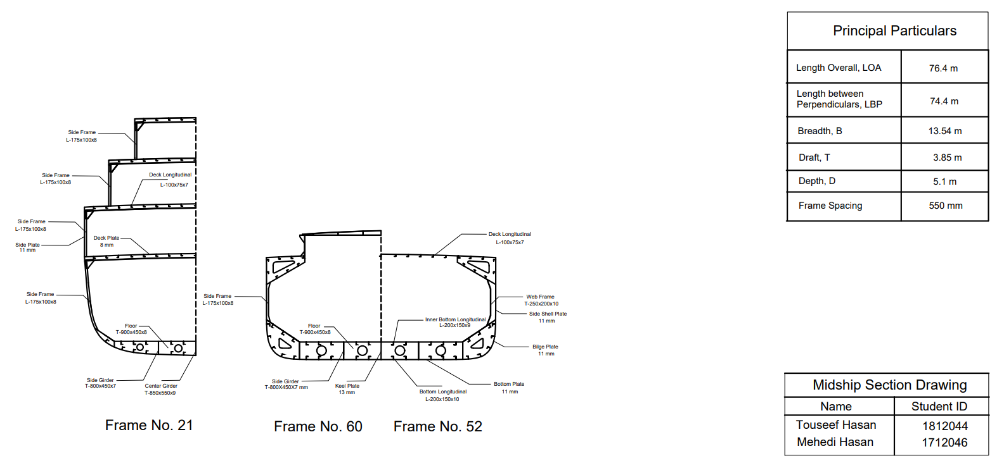
Midship Section Drawing

Slide 13
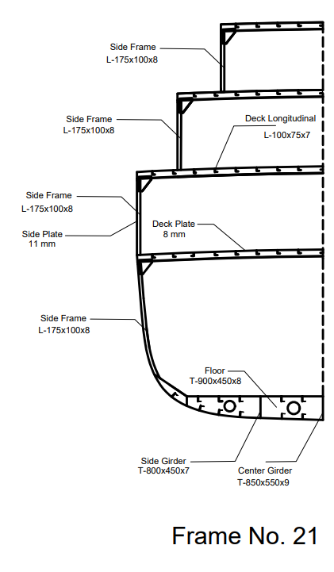
Midship Section Drawing (contd.)

Slide 14
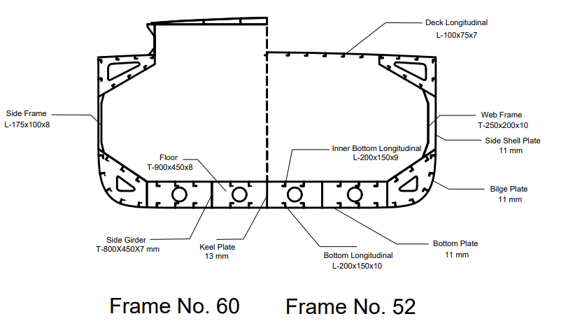
Midship Section Drawing (contd.)

Slide 15
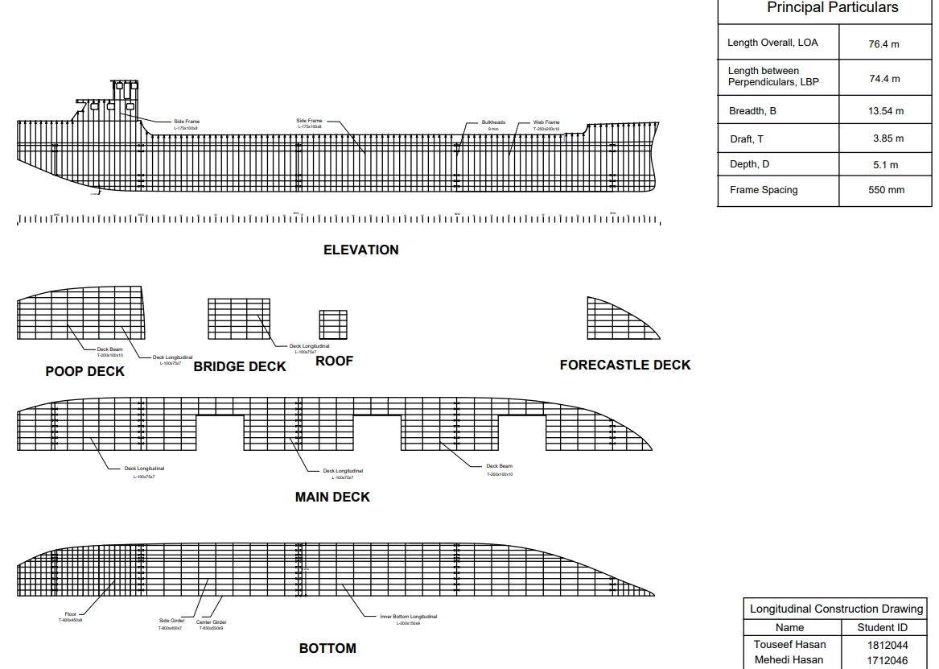
Longitudinal Construction Drawing

Slide 16
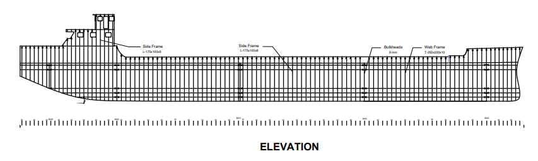
Longitudinal Construction Drawing (contd.)

Slide 17
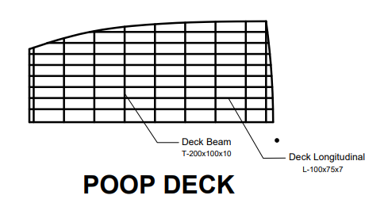
Longitudinal Construction Drawing (contd.)

Slide 18
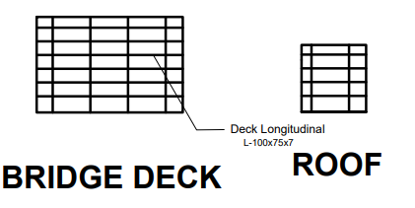
Longitudinal Construction Drawing (contd.)

Slide 19

Longitudinal Construction Drawing (contd.)

Slide 20
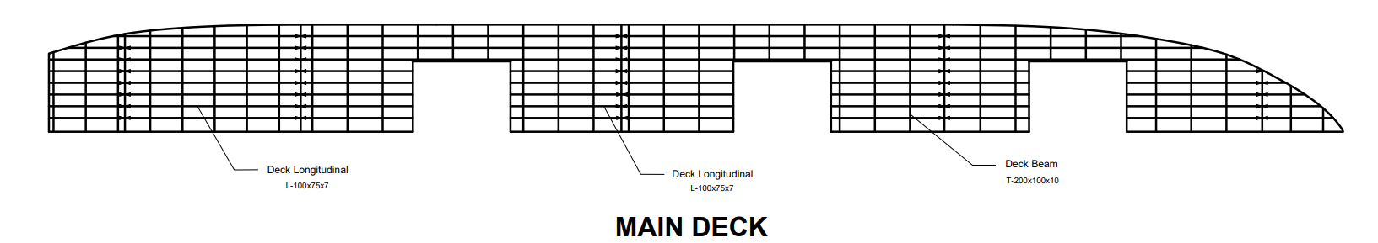
Longitudinal Construction Drawing (contd.)

Slide 21
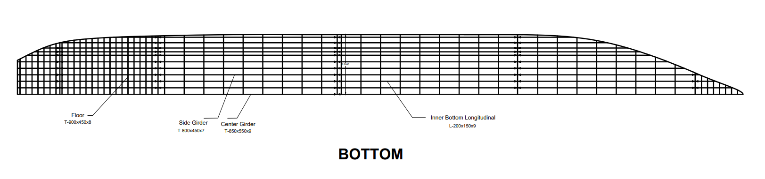
Longitudinal Construction Drawing (contd.)

Slide 22
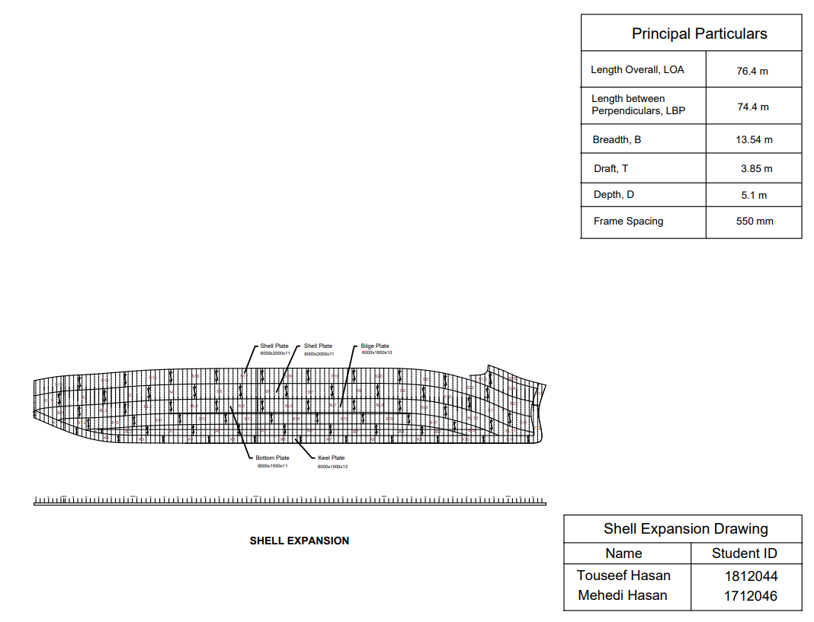
Shell Expansion Drawing

Slide 23
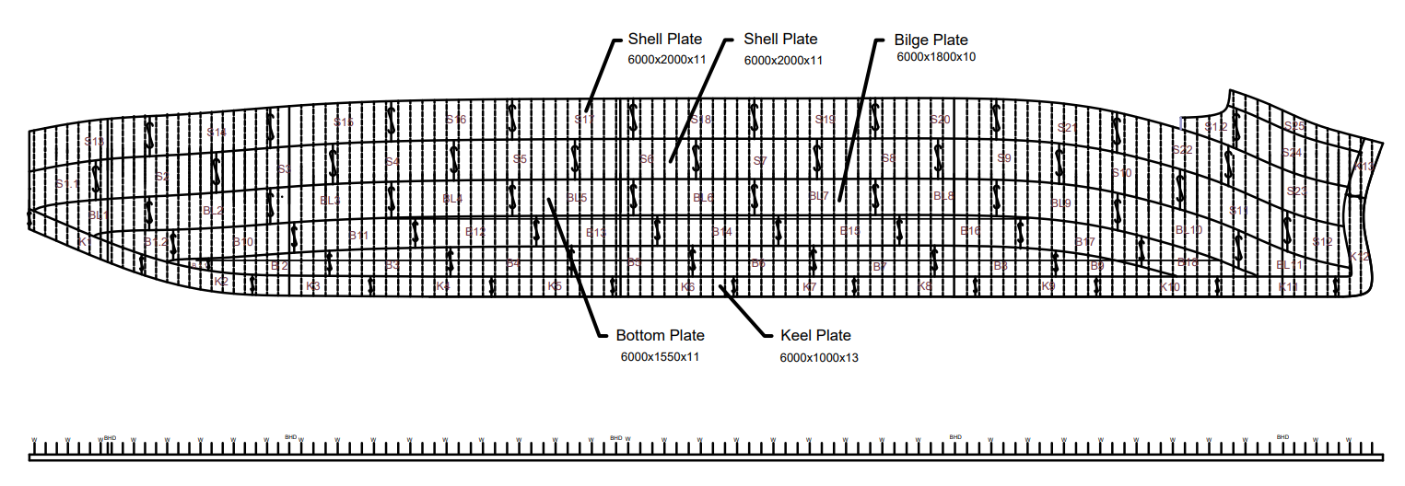
Shell Expansion Drawing (contd.)

Slide 24
Shell Expansion Drawing (contd.)

Slide 25
Thank You.

Slide 26
References
1. Germanischer Lloyd, 13th Edition (GL-13)
2. Illustration of Hull Structures (English/Japanese),
Dr. Hirohiko Emi (Author/Illustrator)

